Slide 1
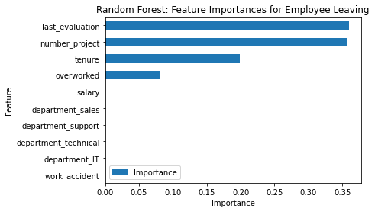
Predicting Employee Attrition at Salifort Motors
Salifort Motors faces a significant challenge with high employee turnover, which impacts productivity and incurs substantial costs related to hiring and training. This project aims to analyze employee survey data and develop a predictive model to forecast employee departures, helping the company address turnover proactively.
The company struggles with a high rate of employees leaving, both voluntarily and involuntarily. This turnover disrupts operations and leads to financial losses. Leadership needs to understand the root causes of attrition and identify employees at risk to improve retention strategies.
Using employee survey data and job-related information such as job title, department, workload, and work hours, various statistical and machine learning models will be built and evaluated. The best-performing model will predict the likelihood of employee departure and highlight key factors driving turnover.
The project involves exploratory data analysis to identify patterns, feature engineering, model training and validation, and interpretation of feature importance. The results will inform targeted recommendations for HR to improve job satisfaction, workload balance, and overall retention. The final deliverable will include a predictive model and actionable insights for leadership.
Image Alt-Text Here
The model highlights employee satisfaction as the most influential factor in predicting attrition, followed by tenure, number of projects, and last evaluation scores. These features strongly impact whether an employee stays or leaves. In contrast, department and salary have minimal influence on predictions.
Salifort Motors should integrate the predictive model into HR workflows to identify employees at risk of leaving and intervene early. Focusing on improving employee satisfaction and balancing workloads can reduce burnout and boost retention. Enhancing regular performance feedback and expanding data collection will help refine insights. Finally, monitoring retention metrics will ensure that interventions are effective over time.

